Slide 1


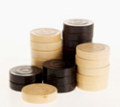
Stack
An ordered group of homogeneous items of elements.

Slide 2
What is a Stack?
A linear data structure.
A stack is a last in, first out (LIFO) data structure
  Items are removed from a stack in the reverse order from the way they were inserted.
A stack is a linear list with the restriction that insertions and deletions can be performed in only one position, namely, the end of the list, called the top.
A stack is also known as pushdown list.

Slide 3
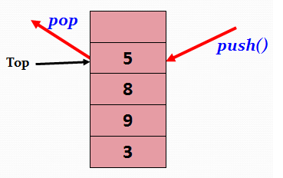

Operations on Stack
Two basic operations are performed on the stack…
Push : inserting value into the stack.
Pop : Deleting value from the stack.
Push and pop can take place only at one end, called top.
Initially top is initialized at -1, i.e., top=-1.

Slide 4
Stack overflow
The condition resulting from trying to push an element onto a full stack.
Here Top= n−1
Stack underflow
The condition resulting from trying to pop an empty stack.
Here Top=−1

Slide 5
Push (newItem)
Function: Adds newItem to the top of the stack.
Preconditions: Stack has been initialized and is not full.
Postconditions: newItem is at the top of the stack.

Slide 6
Algorithm for Push operation
PUSH(STACK, TOP, MAXSTK, ITEM)
This procedure pushes an ITEM onto the stack.
1. [ Stack already filled ? ]
If TOP=MAXSTK, then Print OVERFLOW and Return.
2. Set TOP:=TOP+1 [Increase TOP by 1]
3. Set STACK[TOP]:=ITEM
[Insert ITEM into new TOP position]
4. Return.

Slide 7
push(stk, top, max, item)
{
if(top==max) //max=stackSize-1 or last index
{ printf(“Stack overflow”);
return 0;
}
top=top+1;
stk[top]=item;
return top;
}

Slide 8
Pop (Item)
Function: Removes topItem from stack and returns it in item.
Preconditions: Stack has been initialized and is not empty.
Postconditions: Top element has been removed from stack and item is a copy of the removed element.

Slide 9
Algorithm for Pop operation
POP(STACK, TOP, ITEM)
This procedure deletes the top element of the STACK and assigns it to the variable ITEM.
1. [ Stack is not empty ? ]
If TOP=−1, then Print: UNDERFLOW and Return.
2. Set ITEM:=STACK[TOP] [Assign TOP element to ITEM.]
3. Set TOP:=TOP−1 [Decrease TOP by 1]
4. Return.

Slide 10
pop(stk, top, item)
{
if(top==-1)
{ printf(“Stack underflow or deletion not possible”);
return 0;
}
item=stk[top];
printf(“deleted value is %d” ,item);
top=top-1;
return top;
}

Slide 11
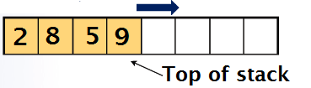
Implementing a Stack
Stacks can be implemented efficiently with both
Arrays
Linked lists
Array implementation of a Stack
Linked-list implementation of a Stack
a linked list provides fast inserts and deletes at head, i.e., keep top of stack at front
H
9
5
8
2 | ×

Slide 12
Application of Stack
Infix to postfix conversion and evaluation.
Web browsers store the addresses of recently visited sites on a stack : Each time the visits a new site that is pushed on the stack. Browsers allow to “pop” back to previously visited site.
The undo-mechanism in an editor : The changes are kept in a stack. When the user presses “undo” the stack of changes is popped.
The function-call mechanism
The active (called but not completed) functions are kept on a stack
Each time a function is called, a new frame describing its context is pushed onto the stack. The context of a method are its parameters, local variables, what needs to be returned, and where to return (the instruction to be executed upon return).
When the function returns, its frame is popped, the context is reset to the previous method (now on top of the stack) and the program continues by executing the previously suspended method.

